Slide 1

Elliptic Curve Integrated Encryption Scheme Implementation for Android Platforms
This presentation explores the implementation of the Elliptic Curve Integrated Encryption Scheme (ECIES) on Android platforms, providing a secure and efficient approach for mobile communications. ECIES combines the benefits of Elliptic Curve Cryptography (ECC) and symmetric encryption, offering robust security with smaller key sizes and faster computations - crucial for resource-constrained mobile devices.

Slide 2
Introduction to ECC and ECIES
Elliptic Curve Cryptography (ECC)
Elliptic Curve Integrated Encryption Scheme (ECIES)
ECC is a public-key cryptography method that uses smaller key sizes compared to traditional RSA, while providing the same level of security. ECC's mathematical foundation on elliptic curves allows for efficient implementation and high-performance encryption, making it well-suited for mobile applications.
ECIES is a hybrid encryption scheme that combines the Diffie-Hellman key exchange protocol with symmetric encryption algorithms, such as AES, and a message authentication code (HMAC-SHA256). This approach offers robust security by leveraging the benefits of both public-key and symmetric-key cryptography.

Slide 3

The Problem
1
Secure Mobile Communications
With the widespread adoption of mobile devices and the increasing reliance on mobile apps for communication, there is a growing need for secure and efficient encryption solutions to protect sensitive data and ensure the privacy of mobile users.
2
Limitations of Traditional Methods
Traditional encryption methods, such as RSA, often require larger key sizes, leading to slower computations and increased resource consumption on mobile platforms. This presents a challenge for the development of high-performance mobile applications that need to balance security and efficiency.
3
Importance of Efficient Encryption
In the context of mobile applications, efficient encryption is crucial to minimize the impact on device performance, battery life, and user experience. Implementing a lightweight and optimized encryption scheme is essential for the widespread adoption and acceptance of secure mobile communications.

Slide 4

Solution: ECIES on Android
Implementation with Spongy Castle
We have implemented the ECIES encryption scheme using the Spongy Castle cryptographic library, which provides a Java-based implementation of various cryptographic algorithms, including ECC and ECIES. Spongy Castle is a popular choice for Android development due to its performance and compatibility with the platform.
Advantages of ECIES
By leveraging ECIES, we can take advantage of the benefits of ECC, such as smaller key sizes and faster computations, while combining it with the security of symmetric encryption algorithms like AES and message authentication with HMAC-SHA256. This approach offers a robust and efficient solution for secure mobile communications.
Key Processes
The main components of our ECIES implementation include key generation, encryption, and decryption. The key generation process utilizes elliptic curves to create the public and private keys, while the encryption and decryption steps involve random number generation, AES encryption/decryption, and HMAC-SHA256 for message authentication.

Slide 5

Implementation Overview
Encryption Process
The encryption process involves generating a random number, using AES for symmetric encryption, and applying HMAC-SHA256 for message authentication, ensuring the confidentiality and integrity of the encrypted data.
Development Tools
We used Java SE 6, Eclipse SDK V4.2.2, and the Spongy Castle cryptographic library to implement the ECIES solution for Android platforms.
1
2
3
Key Generation
The key generation process leverages elliptic curves to create the public and private keys, which are essential for the Diffie-Hellman key exchange and the overall ECIES encryption and decryption operations.

Slide 6




ECIES Key Processes
Key Generation
Elliptic curve-based key generation for public and private keys, enabling secure Diffie-Hellman key exchange.
Encryption
Combining random number generation, AES symmetric encryption, and HMAC-SHA256 for robust data protection.
Decryption
Parsing the encrypted data, deriving the encryption key, and using AES decryption to recover the original message.

Slide 7
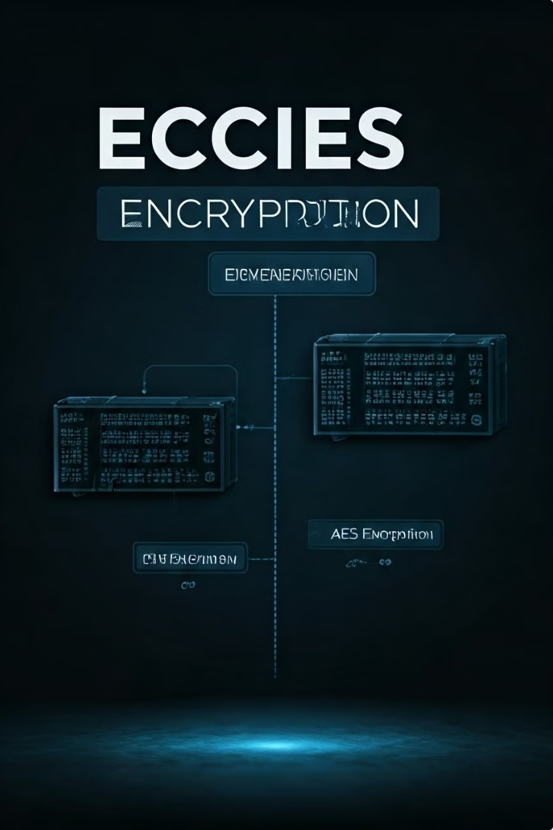



ECIES Encryption Process
Key Generation
Generate public and private keys using elliptic curve cryptography.
Diffie-Hellman Key Exchange
Perform a Diffie-Hellman key exchange to establish a shared secret key.
AES Encryption
Use the shared secret key to encrypt the plaintext message using the AES algorithm.

Slide 8




ECIES Decryption Process
Data Parsing
Parse the encrypted data to extract the necessary components, such as the Diffie-Hellman public key and the ciphertext.
Key Derivation
Derive the shared secret key using the local private key and the received public key from the Diffie-Hellman key exchange.
AES Decryption
Use the derived shared secret key to decrypt the ciphertext using the AES algorithm, recovering the original plaintext message.

Slide 9

Performance Considerations
Metric
ECIES on Android
Traditional RSA
Key Size
256 bits
2048 bits
Encryption Time
Faster
Slower
Memory Usage
Lower
Higher
Energy Consumption
Lower
Higher

Slide 10

Conclusion
Secure and Efficient Mobile Encryption
The implementation of ECIES on Android platforms provides a robust and efficient solution for secure mobile communications. By leveraging the benefits of ECC and combining it with symmetric encryption, ECIES offers smaller key sizes, faster computations, and lower resource consumption - crucial for the development of high-performance mobile applications.
Ongoing Development and Future Work
This presentation showcases our initial ECIES implementation for Android, but the development and optimization of secure mobile encryption solutions is an ongoing process. We will continue to refine and enhance the ECIES implementation, exploring performance improvements, integration with other security frameworks, and potential extensions to support emerging mobile technologies and use cases.

